Slide 1
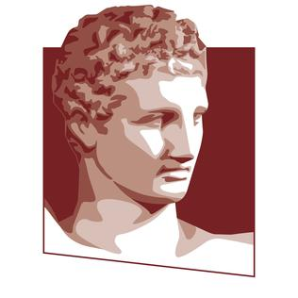


Handwriting Image Recognition
Machine Learning and Content Analytics
Evangelia Arseniou (p2822026) Paraskevi Barmpa (p2822013) Sotiria Ligkou (p2822023)

Slide 2

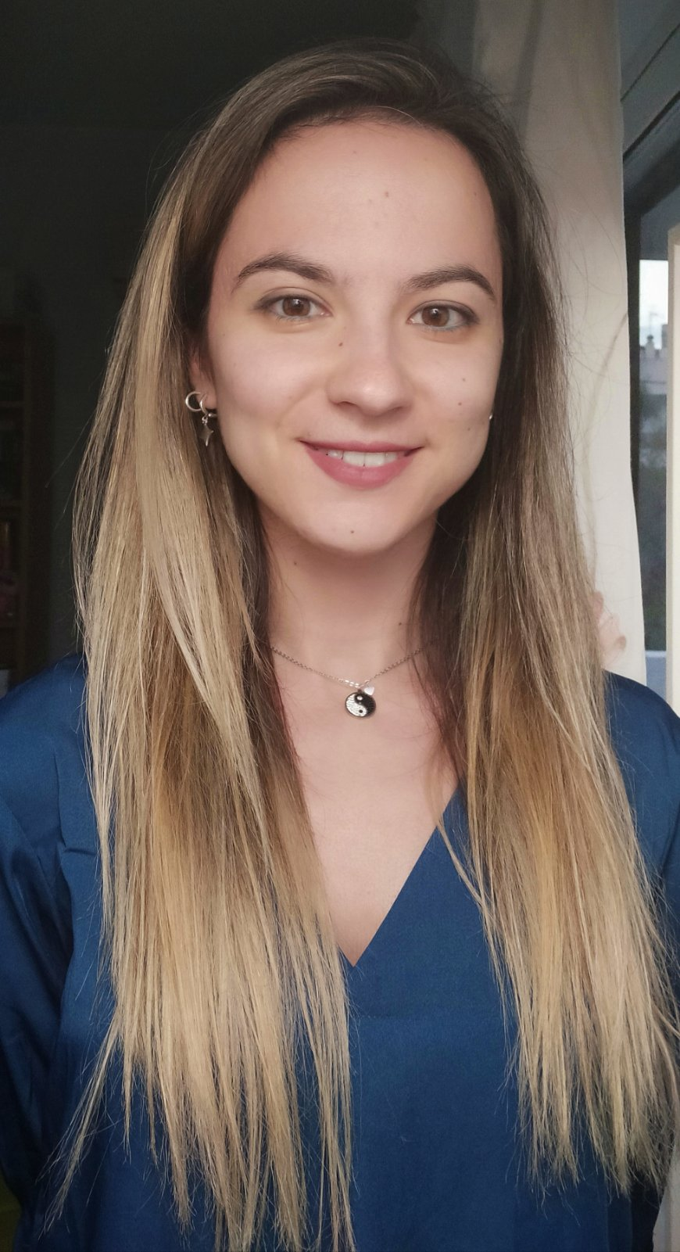
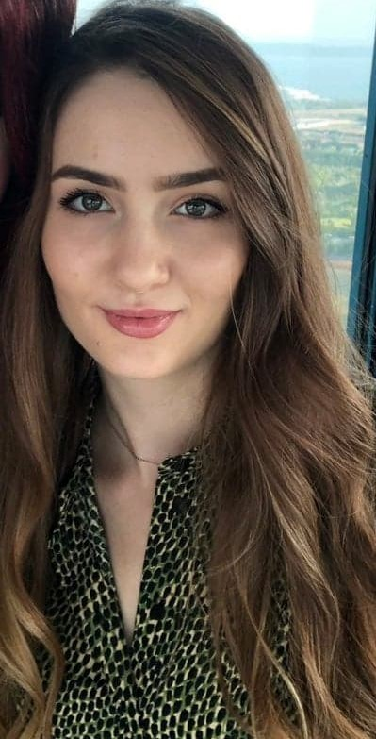
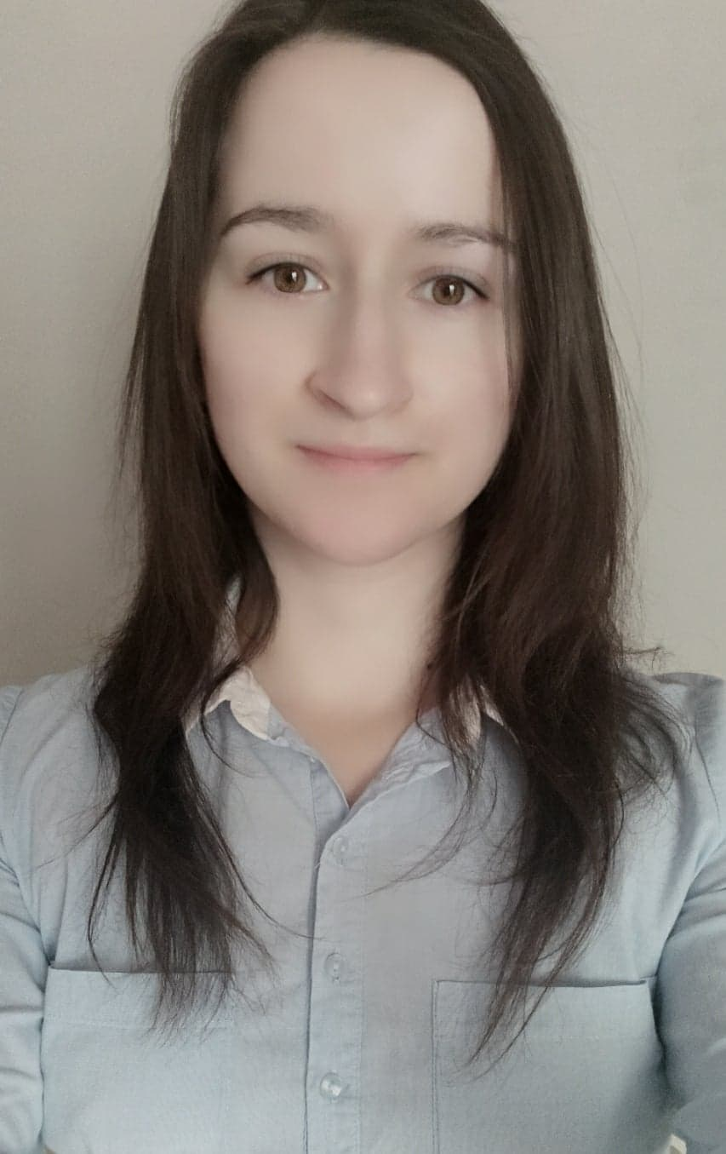
Who we are?
Start – up company
New York city
Specializing in app development
We are the Business Analytics team of EBS company and our aim is to present our latest app called “DigitPen”.

Slide 3


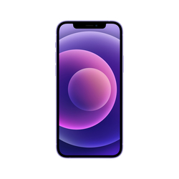
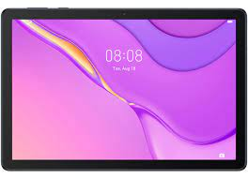



Business Case
DigitPen App is here!
Have you ever thought how time consuming
and exhausting is to manually transcribing
large amounts of handwritten data?
DigitPen is a handwriting recognition technology app
Users upload handwritten images in English through
mobile
tablet
laptop
The app converts the handwritten text into digital form by using machine learning techniques

Slide 4

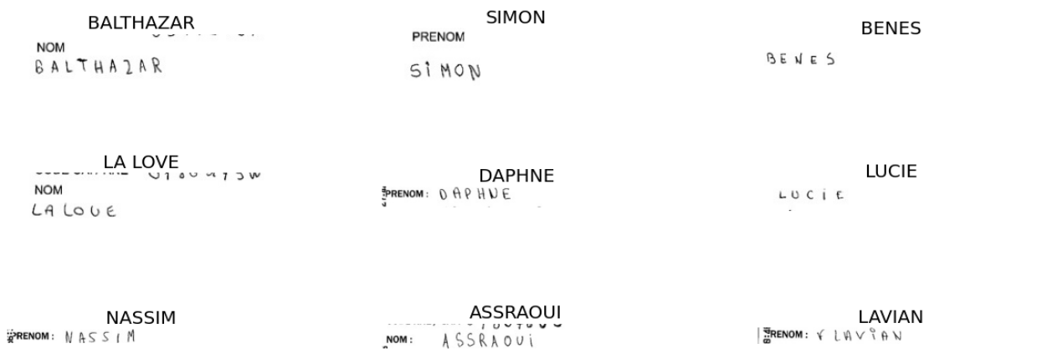

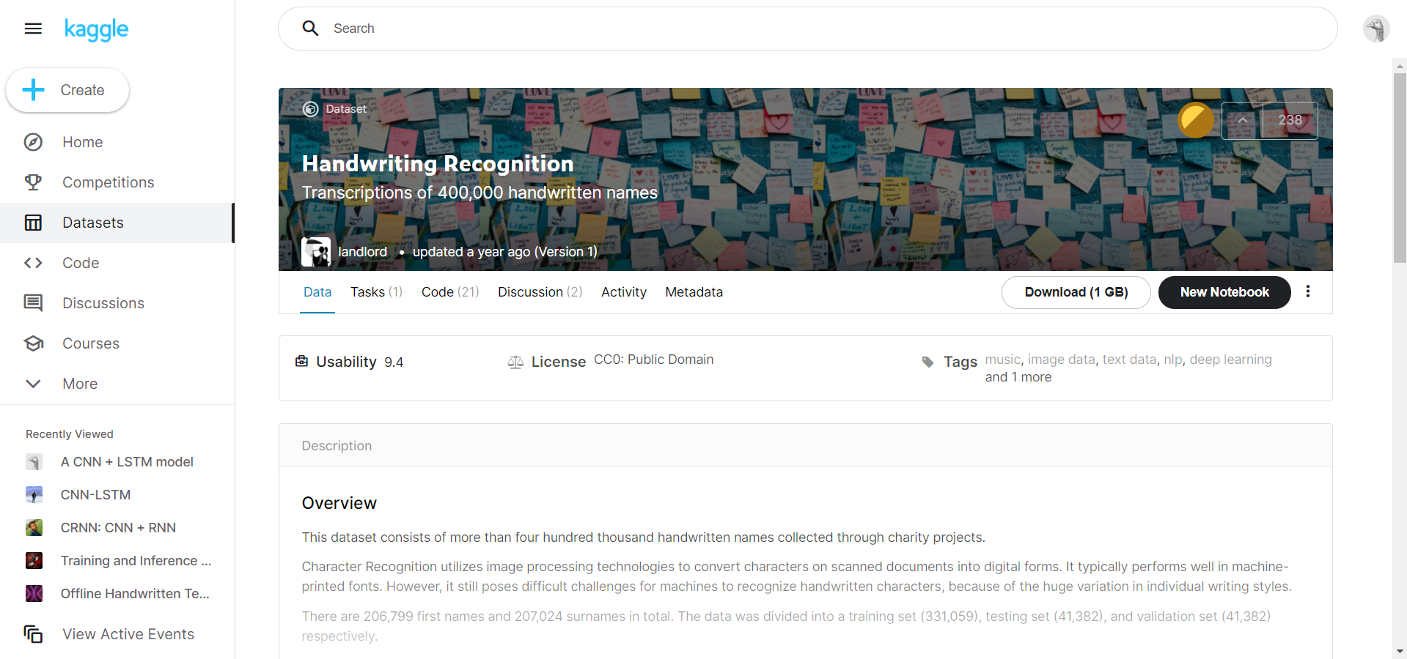
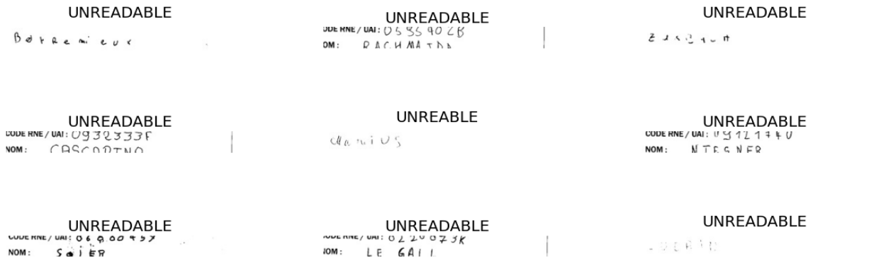
Dataset Overview
3 csv files
+
3 folders
containing handwritten images

Slide 5
Dataset Preprocessing
Steps for the initial 3 csv files:
4
3
Create the input and output variables (labels)
2
Define
Train set (30,000)
Validation set (3,000)
test set (1,000)
EXAMPLE
Load images as
grayscale format
reshape to 256 width and 64 height and
rotate 90 degrees
1
BALTHAZAR
Characters of Identity column into upper case letters
Remove rows with NA values and Unreadable labels
[1 0 11 19 7 0 25 0 17]

Slide 6
Building the Models
Model 1. Feedforward Neural Network (FNN)
FNN takes 1-dimension vector as input
Flatten the training images before apply FNN
images
height
width
Training images shape
(30000, 256, 64, 1)
Channel
(size is 1 since each grayscale pixel
can be represented by 1 value)
Original shape
RESHAPE
16,384 neurons
(30000, 256x64x1)
After Flattening

Slide 7
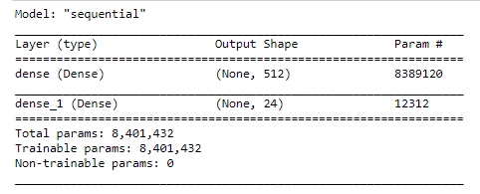
Building the Models
Model 1. Feedforward Neural Network (FNN)
FNN
Optimizer
RMSProp
Loss Function
Mean Absolute Error
Epochs 30
Batch Size 128
Input Layer: 16384 neurons
Hidden Layer: ReLU Activation
Output Layer: Softmax Activation
Accuracy | Result
Train | 14.98%
Validation | 15.13%
Test | 14.90%

Slide 8
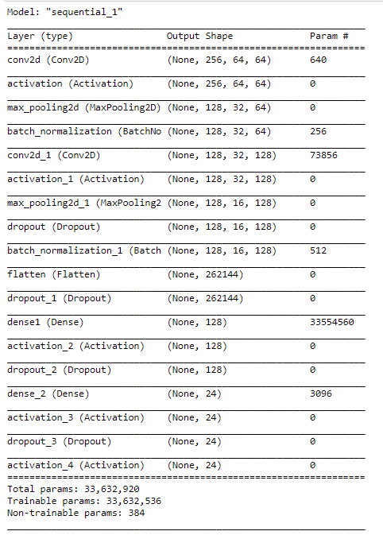


Building the Models
Model 2. Convolutional Neural Network (CNN)
CNN is comprised of 5 layers
Optimizer: Adam
2D Convolution layer
ReLU Activation
MaxPooling2D
Batch Normalization
Dropout 30%
Flatten
Softmax Activation
Train & Validation accuracy$≅22\%$
Test accuracy$=23.50\%$

Slide 9
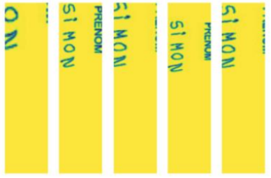
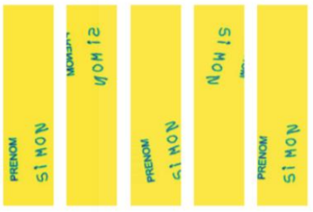
Data Augmentation on CNN model
Idea: Generate new training samples from the original ones
How: Apply random jitters and perturbations
Why: Increase the generalizability of the model
Methods: Horizontal flips, random brightness, zoom, rotations, etc.
Zoom and Brightness Technique
Rotation Technique
ImageDataGenerator constructor
Zoom range: 0,4 to 1,0 (40% zoom)
Brightness range: 0,2 to 1,0 (darker images)
Rotation range from 0 to 30 degrees
Horizontal and Vertical flip
Train Accuracy: 22,46%
Validation Accuracy: 23,17%
Test Accuracy: 12,70%
30 epochs (stopped at 4th epoch)
128 batch size
Callbacks Early Stopping
Train Accuracy: 16.26%
Validation Accuracy: 15.13%
Test Accuracy: 23.50%

Slide 10
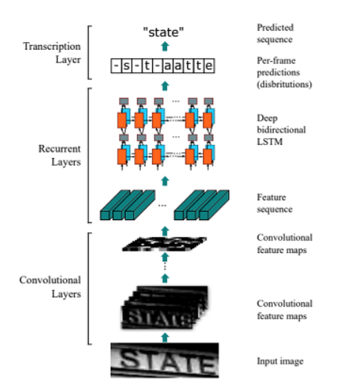
Building the Models
Model 5. Convolutional Recurrent Neural Network (CRNN)
CRNN involves CNN followed by RNN to process images containing sequence information such as letters.
Mainly used for Optical Character Recognition technology.
CNN analyzes the image and sends the important features
that have detected to the recurrent part.
Recurrent part analyzes these features in order, taking into
consideration previous information to find important links
between these features that influence the output.

Slide 11
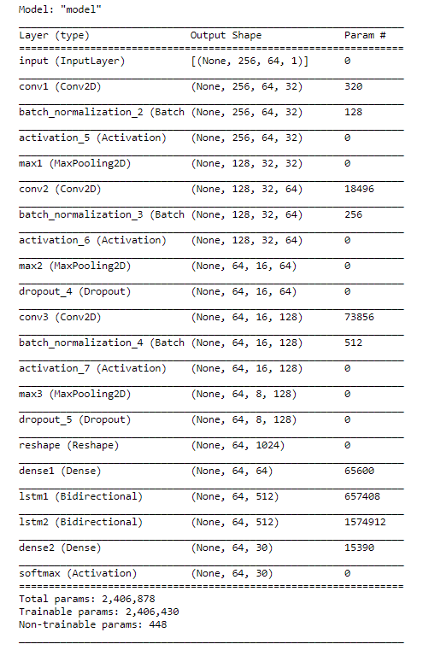
Building the Models
Model 5. Convolutional Recurrent Neural Network (CRNN)
Image 64x256
Input
Extracts feature sequence from each input image
Convolutional Layer
Batch Normalization
Accelerates the training process
Replaces all negative values to zero
RELU Activation
Max Pooling
Dense
Dimensionality reduction process
Improve the training process
Reshape
Converts feature vector from 3D to 2D
Dropout 30%
Prevents CRNN from overfitting
Remembers long sequence data
LSTM
Dense
Mapping the output of LSTM to character labels space
SoftMax Activation
Estimates the prediction probabilities for each class
Loss Function: CTC
Optimizer: RMSprop
Metric: Accuracy

Slide 12
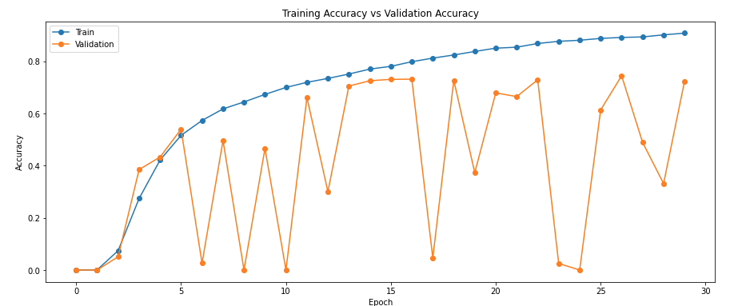
Accuracy metric of CRNN model
91%
75%
For both datasets the accuracy is increasing till epoch 4, then for the
train dataset the accuracy is still increasing but with a decreasing rate while for the validation dataset
the accuracy has many fluctuations.

Slide 13
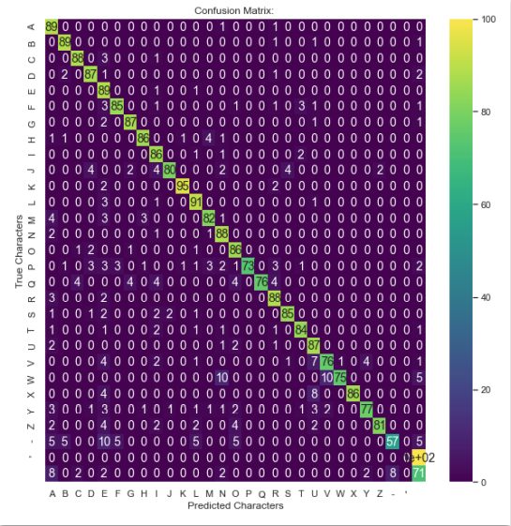
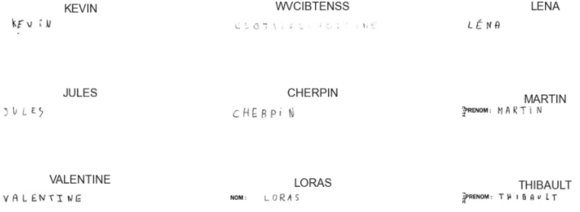
Evaluation of CRNN in the test dataset
Correct Characters 88%
Correct Words 72%
Some predictions

Slide 14
Pre-trained Models
VGG – 16
2. VGG – 19
3. ResNet50
Before apply the models, we reshape the images into 128x128x3
Loss Function: Mean Absolute Error
Optimizer: Adam
Metric: Accuracy
Epochs: 30
Batch Size: 128
Model | Training Accuracy | Validation Accuracy
VGG - 16 | 20.41% | 18%
VGG - 19 | 18.58% | 18.90%
ResNet50 | 19.08% | 16.80%

Slide 15

Conclusion
Did you find our insights helpful?
We hope that the present project of our work will help others to improve the handwritten recognition method they use as there is always room for improvement in the field of computer vision.

Slide 16

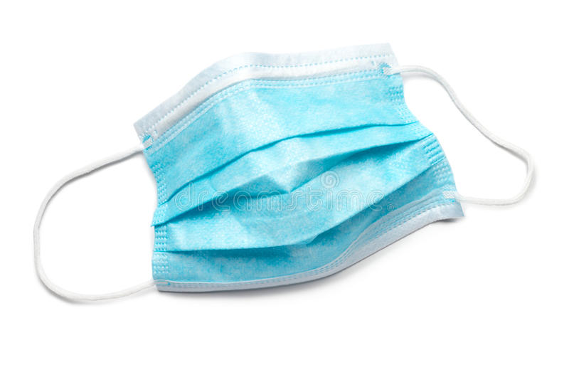
Questions & Thoughts?
Eva
Vivi
Sotiria
Thank you ☺

